Slide 1
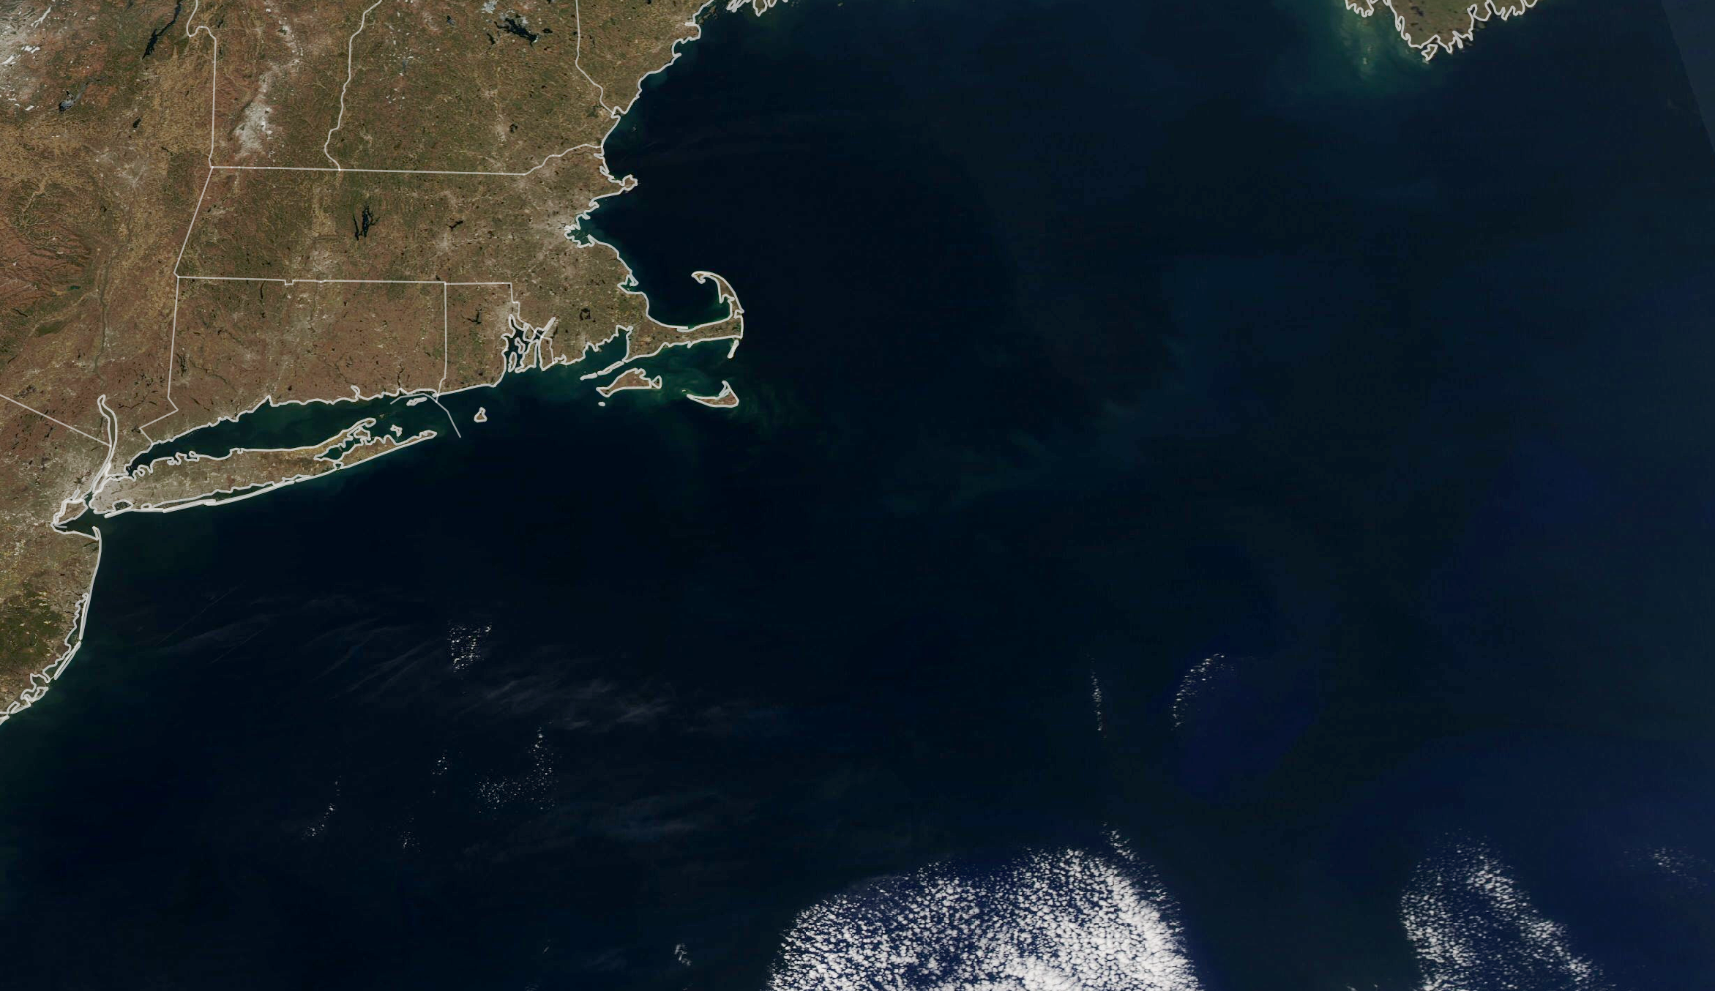

Studying Carbon Cycle & Ecosystems
Julie A. Robinson, Ph.D.
Deputy Director, Earth Science Division
Science Mission Directorate, NASA
May 10, 2023
Notes:
CC&E Joint Science Workshop
May 10, 2023
College Park, Md.

Slide 2
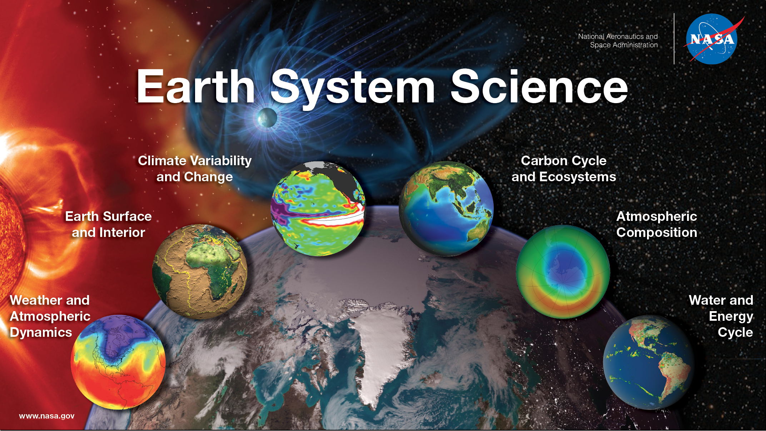

Slide 3
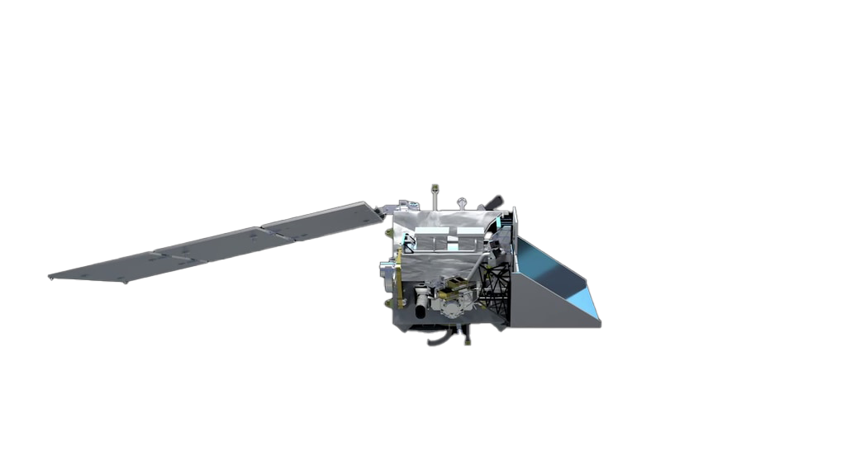
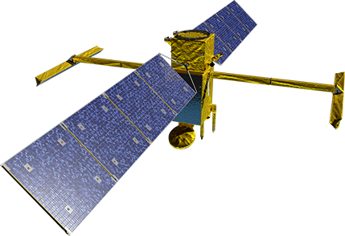
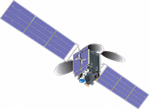
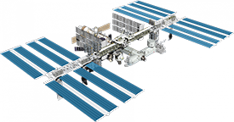
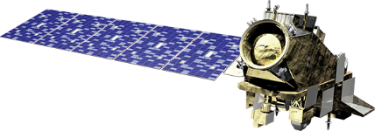
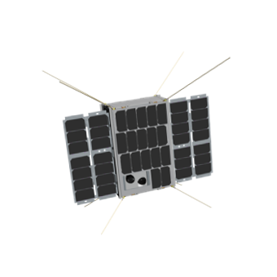
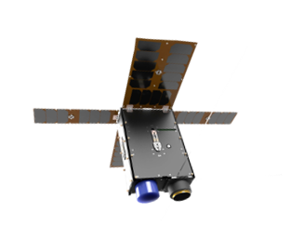
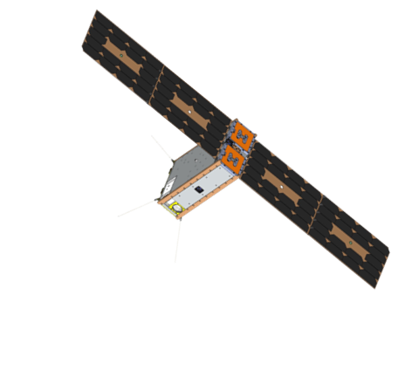
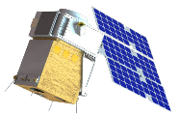
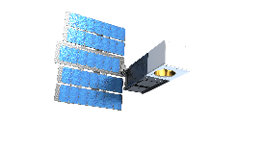
Recent and Upcoming Earth Science Launches
EMIT (ISS)
SWOT
TEMPO*
PACE****
OMPS-Limb (JPSS-2/NOAA)
2022
2023
2024
July
November
December
January
April
May
February
May
June
HyTI*****
TROPICS 2, 3**
CTIM-FD
MURI
SNOOPI***
*Agency LRD March 2023
**Agency LRD November 2023
***Launch Date NET February 2024
****Agency LRD May 2024
*****Launch Date NET June 2024
03.28.23

Slide 4
















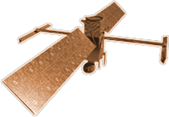









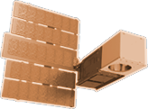



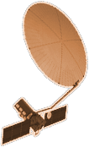



CYGNSS (8)
NISTAR, EPIC
2015
GRACE-FO (2)
SMAP
ICESAT-2
OCO-2
2020
LIS
SAGE III
GPM
SENTINEL-6
MICHAEL FREILICH
TSIS-1
EARTH FLEET
LANDSAT 8
ECOSTRESS
LANDSAT-9
SUOMI NPP
INVEST/CUBESATS
GEDI
CIRIS 2023
NACHOS 2022
CTIM 2022
NACHOS-2 2022
MURI-FD 2022
SNOOPI* 2023
HYTI* 2023
OCO-3
1995
2010
SWOT
LANDSAT 7
CALIPSO
EMIT
TERRA
TEMPO
CLOUDSAT
AQUA
AURA
JPSS INSTRUMENTS
CLARREO-PF
TROPICS (4)
2000
OMPS-LIMB 2022
LIBERA 2027
OMPS-LIMB 2027
OMPS-LIMB 2032
2005
PACE
PREFIRE (2)
ISS INSTRUMENTS
KEY
NISAR
INTERNATIONAL PARTNERS
U.S. PARTNER
ISS INSTRUMENT
JPSS INSTRUMENT
CUBESAT
LAUNCH DATE TBD
TSIS-2*
MAIA*
SENTINEL-6B
INCUS*
(PRE) FORMULATION
IMPLEMENTATION
OPERATING
EXTENDED
GLIMR*
LANDSAT NEXT*
ESO-1, 2, 3, 4*
MISSIONS
04.18.23
2025

Slide 5





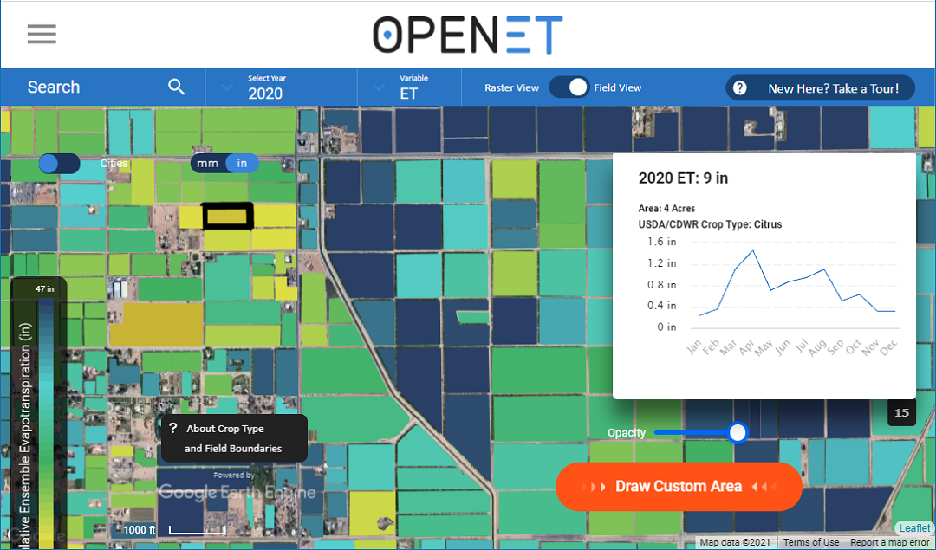

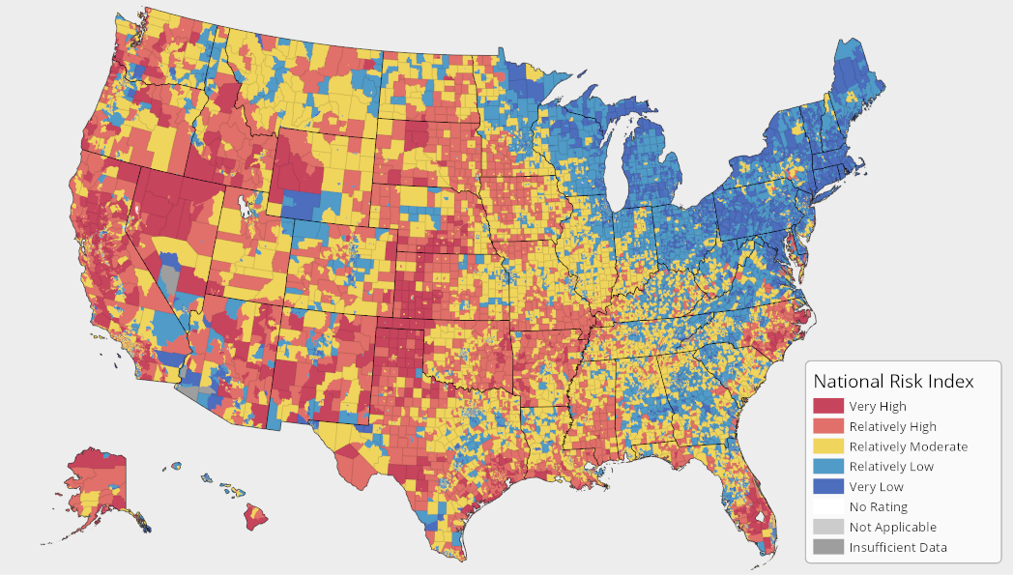


NASA Enables Climate-Informed Services Across the USG

Slide 6
Core Links in USG Climate Services Knowledge Value Chain
Generate climate information:
Observations
Modeling and simulation
Indigenous and traditional knowledge
Lived experience
Deliver climate services:
Mapping and visualization
Extension services
Training and capacity building
Storytelling
Evaluate climate services:
Peer review
User surveys
Benefit/cost analysis
Randomized control trials
Generate
Develop
Deliver
Use
Evaluate
Develop climate services:
Science translation
User engagement
Design co-production
Application development
Use climate services:
Risk assessment
Hazard mitigation
Project design and planning
Investing and asset management

Slide 7
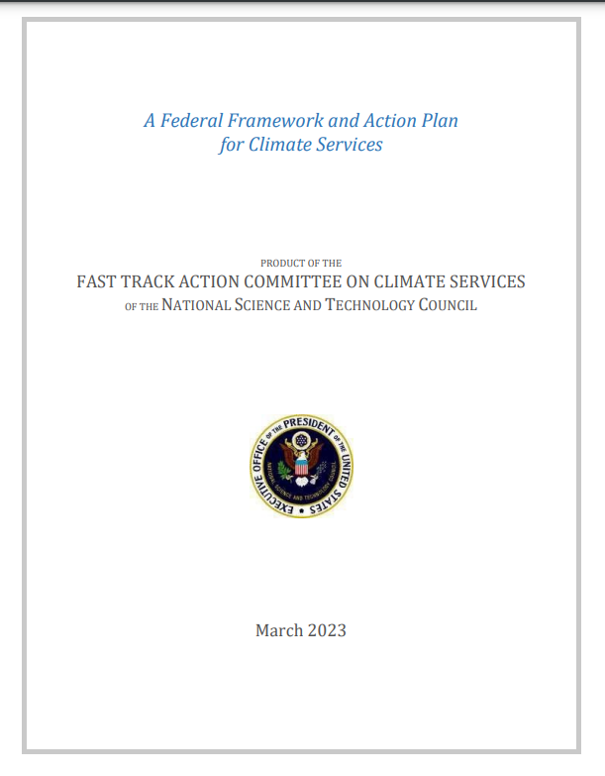
White House Fast Track Action Committee on Climate Services: Whole-of-Government Approach
FTAC was composed of 17 federal government departments and agencies
Principles for federal coordination from final report:
Recognizing the development, delivery, and use of climate services is a shared, whole-of-government responsibility
Aligning climate services investments to the existing authorities, expertise, technical capabilities, and stakeholder relationships within each agency
Prioritizing the user experience in terms of discoverability, design, and usability of data, products, and tools
Maintaining internal consistency across the Federal Government with respect to climate data, products, and tools, while maintaining flexibility to meet the diverse needs of agencies and their stakeholders
Identified USGCRP as mechanism for whole-of-government solution
Consistent with 2022 USGCRP Decadal Strategic Plan
https://www.whitehouse.gov/wp-content/uploads/2023/03/FTAC_Report_03222023_508.pdf

Slide 8
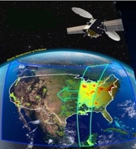
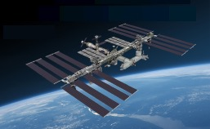
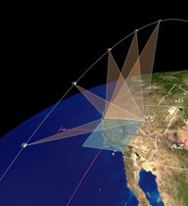

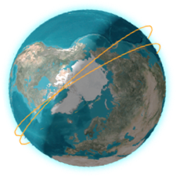
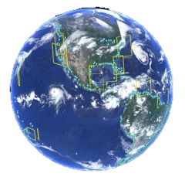
EVI-6 Announcement of Opportunity (AO)
Final AO released April 19, 2022
AO closed September 1, 2022
Selection anticipated in Q3 FY23
PI-Managed Mission Cost Cap of $37M (FY24)
NASA will determine platform and launch vehicle
Solicits Class D instruments and CubeSats
EVI-1
TEMPO
EVI-2
GEDI & ECOSTRESS
EVI-3
TROPICS
EVI-3
MAIA
EVI-6
TBD
EVI-4
PREFIRE
EVI-4
EMIT
EVI-5
GLIMR

Slide 9
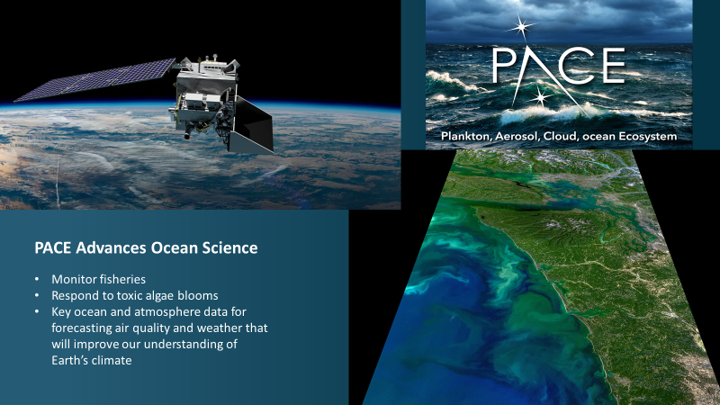

Slide 10
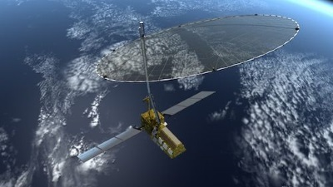
NISAR: Trailblazer to ESO
Not Just “What” We’re Doing, But “How” We’re Doing It
NASA-Indian Space Research Organisation Synthetic Aperture Radar (NISAR)
First time this radar technology will be deployed in orbit
Open Source Science Principles
International Partnership
Launch Date NET October 2024

Slide 11
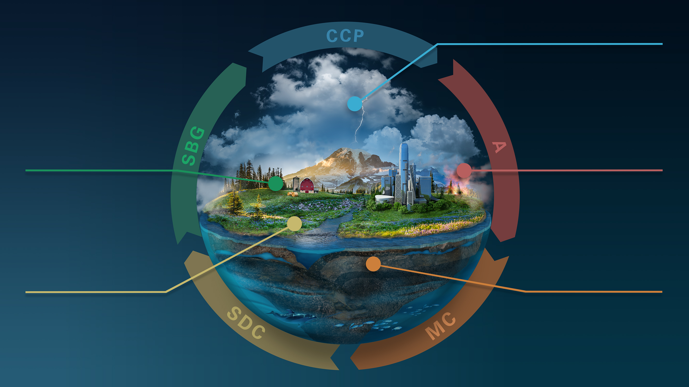

CLOUDS, CONVECTION
AND PRECIPITATION
Water and Energy in
the Atmosphere
INTERCONNECTED
CORE MISSIONS
SURFACE BIOLOGY
AND GEOLOGY
AEROSOLS
Particles in the
Atmosphere
Earth Surface & Ecosystems
SURFACE DEFORMATION
AND CHANGE
MASS CHANGE
Large-scale Mass
Redistribution
Earth Surface Dynamics

Slide 12

AOS-Sky
AOS-Storm
NASA’s Four New ESO Missions
SBG
MC
Atmosphere Observing System
What they do
  Observe aerosols, clouds, convection, and precipitation to learn how they affect linkages between energy and water cycles, a key source of uncertainty in predicting climate change.
Why it matters
  Improved prediction of severe weather, including tornados and atmospheric rivers
  Seasonal snowpack, droughts, tropical storms, wildfires
  Air quality forecasting, including dust and smoke events
Surface Biology and Geology
What it does
  Observe land surface to understand fluxes of carbon, water, nutrients, and energy within and between ecosystems and the atmosphere, the ocean, and the Earth.
Why it matters
  Info for agriculture producers such as crop stress and planting times/locations
  Forest management
  Biodiversity and carbon mitigation: coastal submerged vegetation, carbon sequestration
Mass Change
What it does
  Observe ice, water cycle, and Earth dynamics through gravimetric measurements to understand the drivers of sea level rise, Earth’s energy imbalance, and ice mass loss from the world’s ice sheets.
Why it matters
  Drought assessment and forecasting
  Water use planning in agriculture and urban areas
  Predictive tools used by emergency managers, meteorologists, geologists

Slide 13
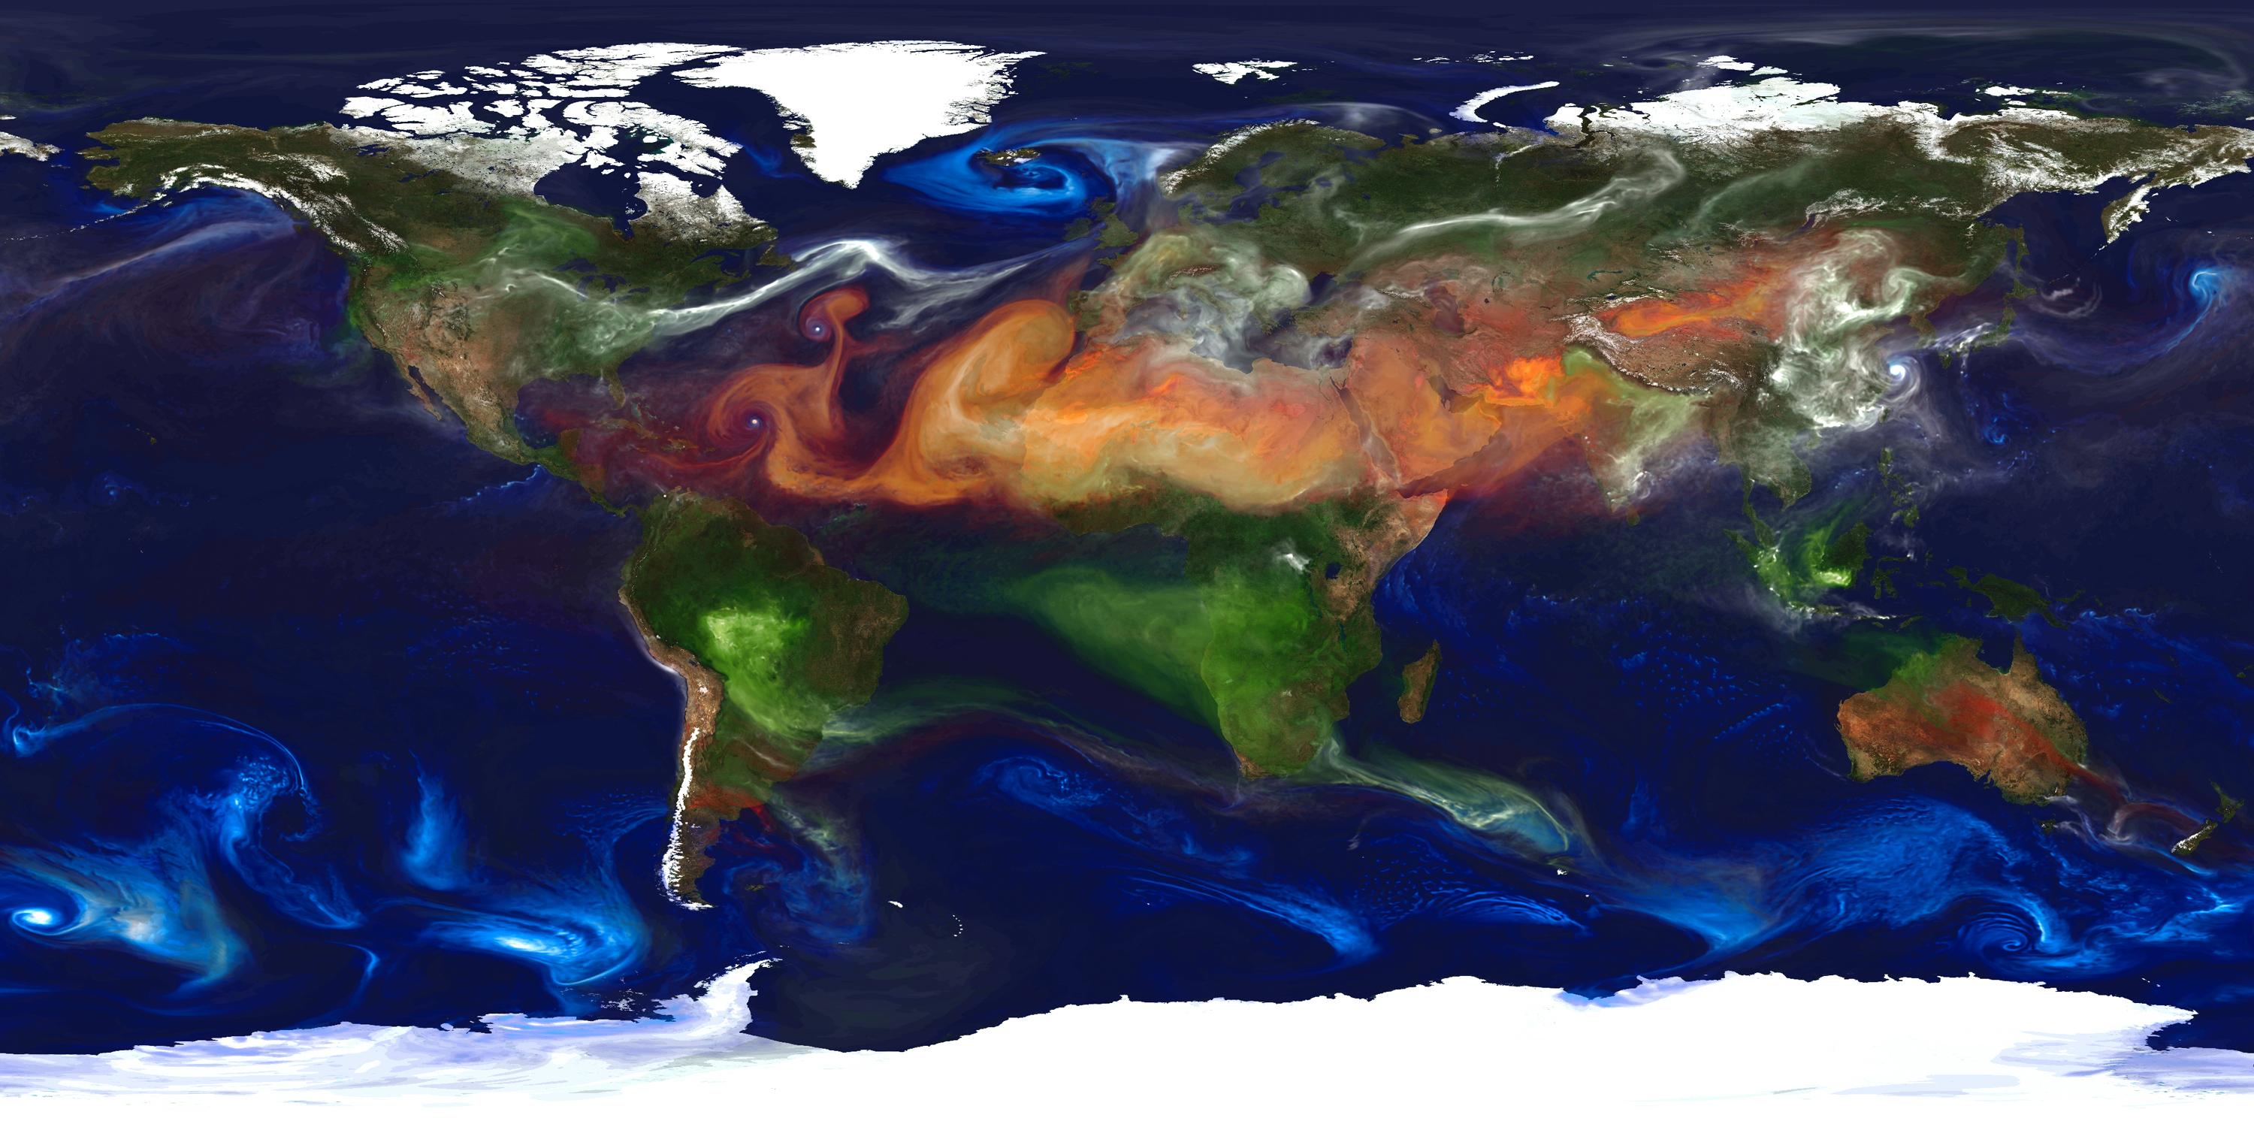

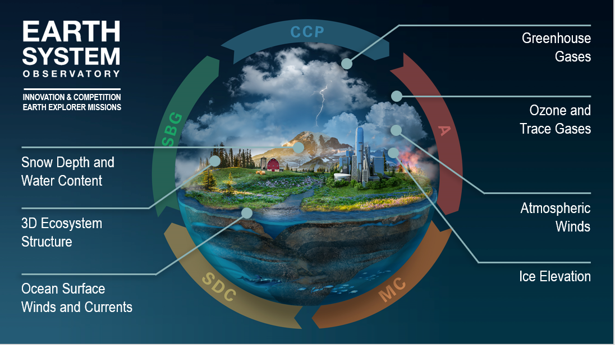
Earth System
Explorers (ESE)
Draft Announcement of Opportunity (AO) released on Dec 6, 2022
Final AO released on May 2, 2023
PI-Managed Mission Cost (PIMMC) cap of $310M (FY24 $)
NASA will provide launch vehicle services
Two-step selection process
New Earth System Explorers Program Office in process of being stood up at GSFC

Slide 14

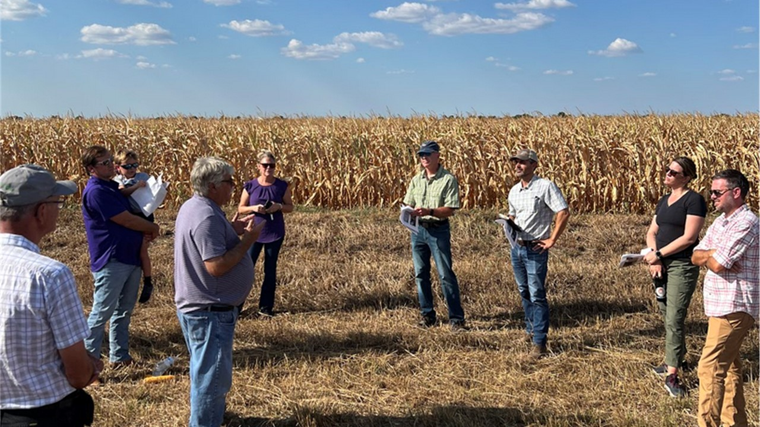
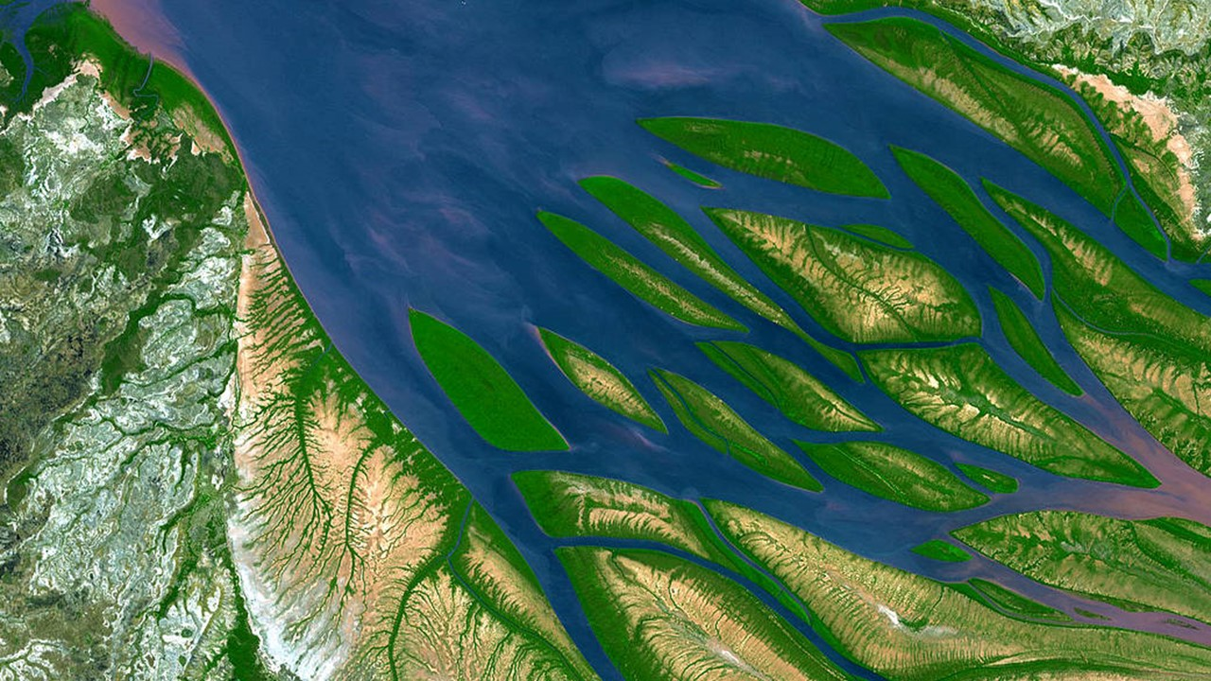
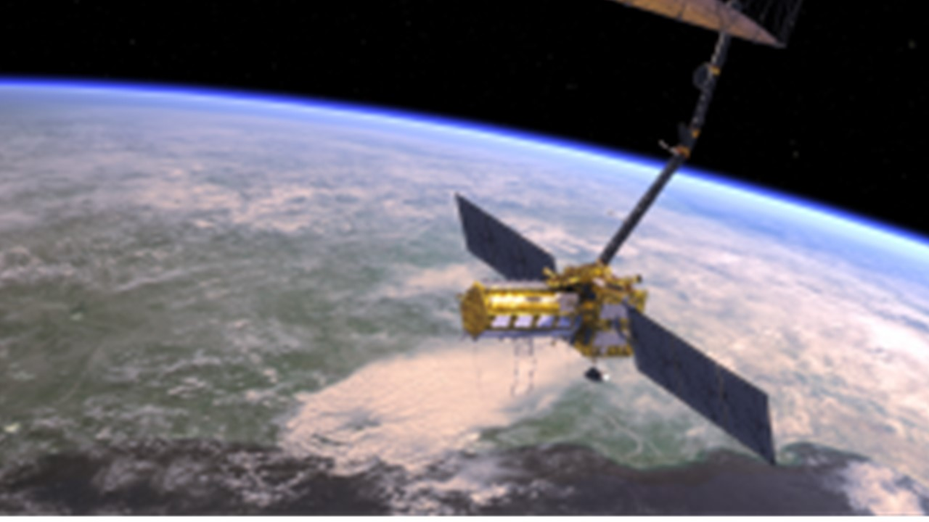
NASA Earth Action Strategy
New Earth Information Center
Earth Science to Earth Action
Earth Action Solutions for Impact
Earth System Science & Applications Incubation
Earth System Observations

Slide 15


Notes:
https://images.nasa.gov/details-iss040e081123

